Slide 1


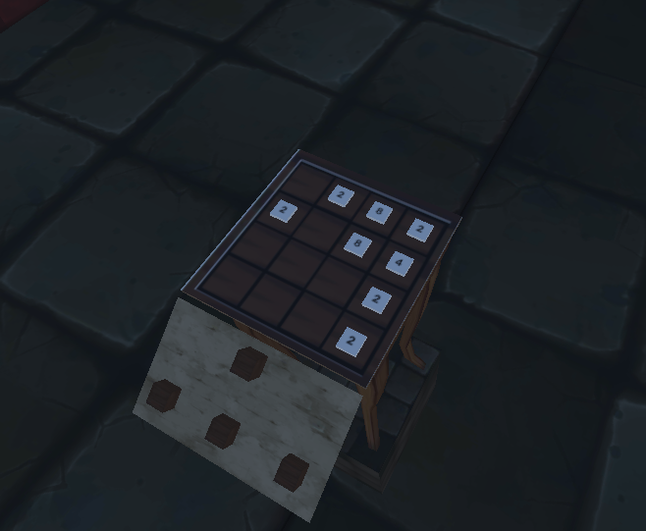
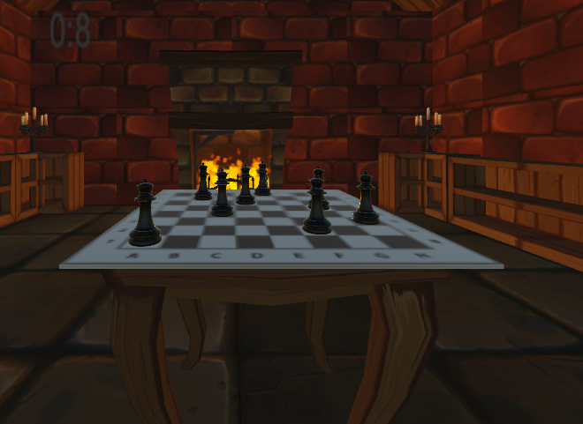
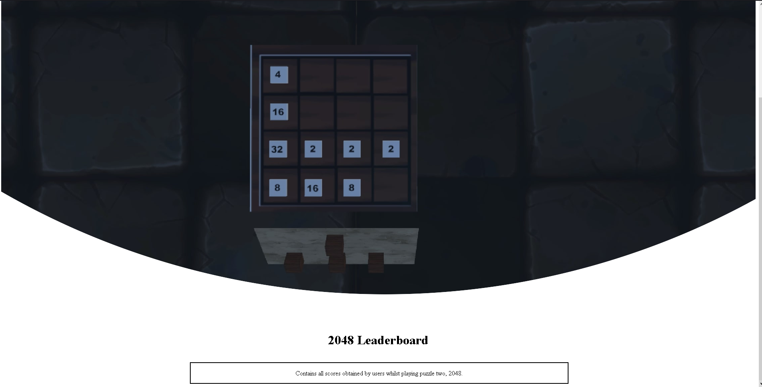
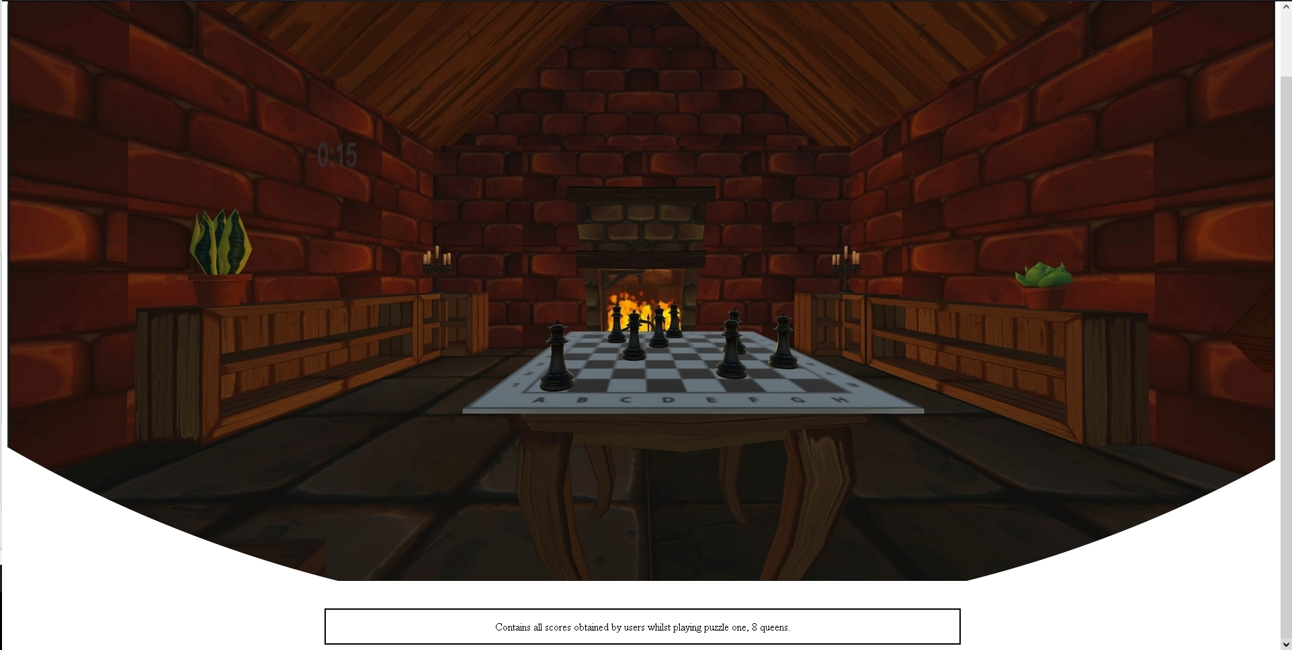
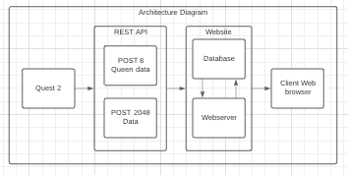
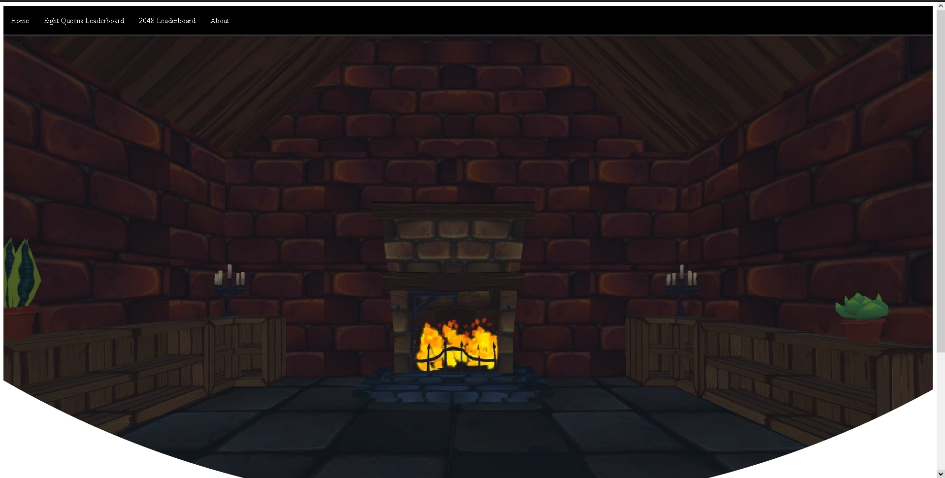
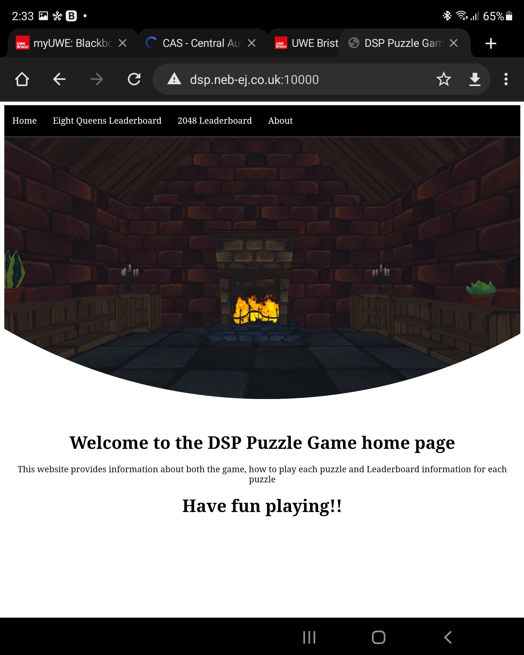
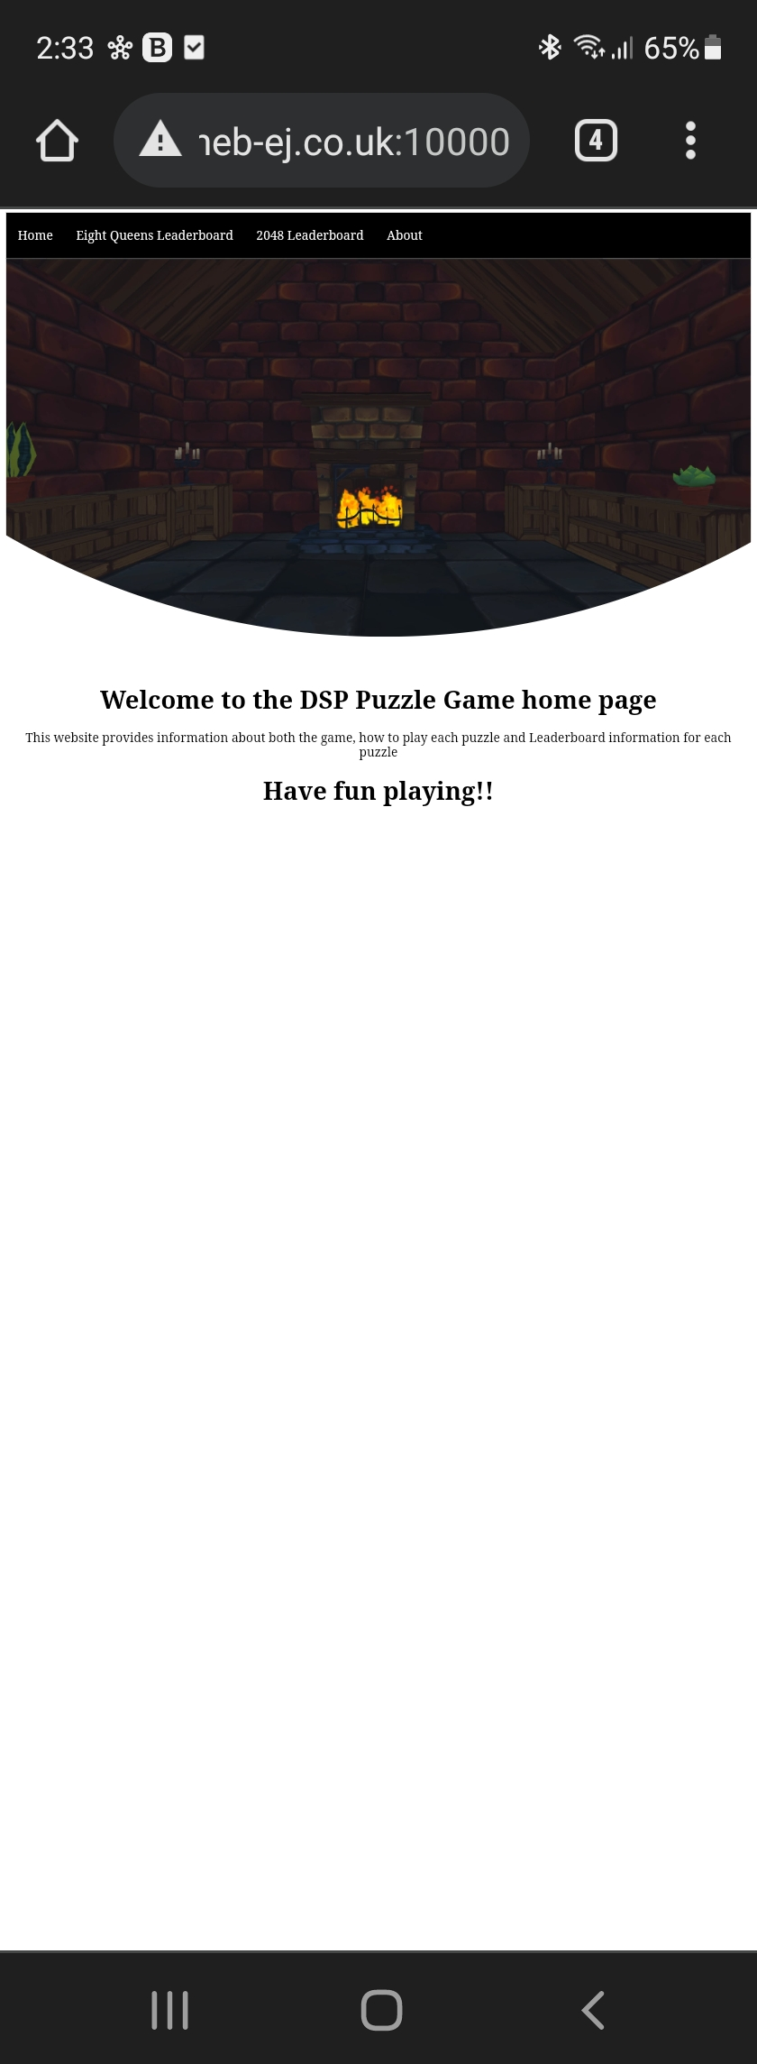
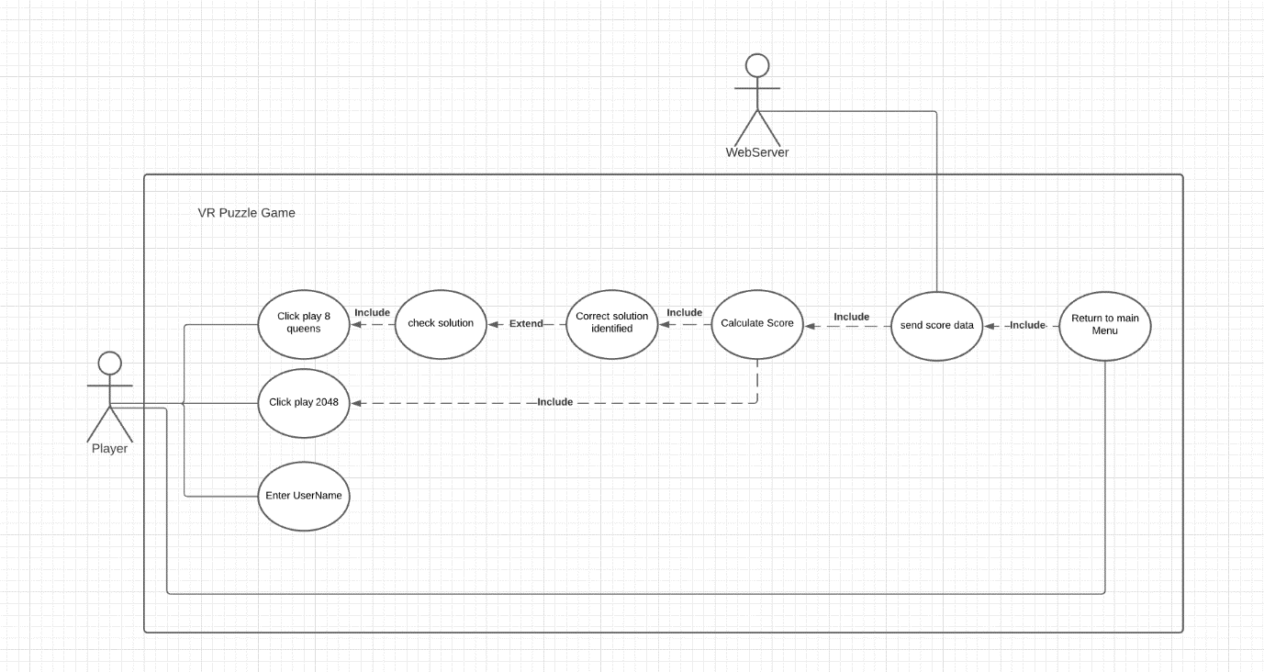
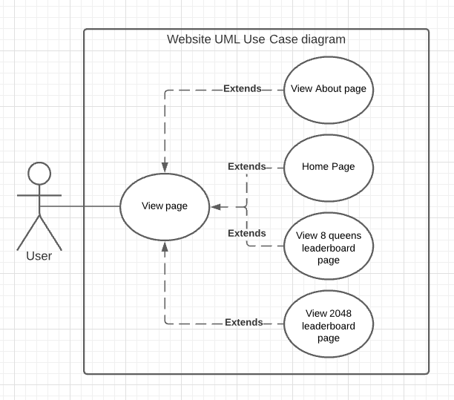
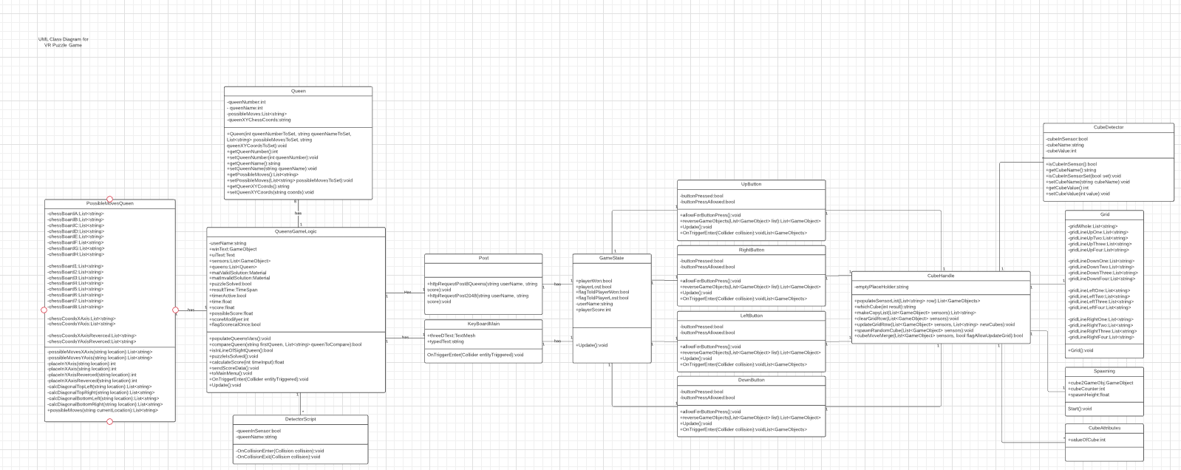
Research: VR in past and present media The first book, William Gibson’s Virtual light, in summary, is about a pair of glasses which allow a person to view information by feeding it into that person’s optic nerve (Gibson et al., 1993). Ready player one is a dystopian future in which people use virtual reality to escape the tough reality of life. The VR world they go to is called the Oasis (Cline et al., 2011). The metaverse The metaverse can be described as a 3-dimensional virtual universe (Dionisio, III, Gilbert, 2013). This however differs from the concept of cyberspace that represents all of a shared online and virtual space across all dimensions (Dionisio, III, Gilbert, 2013). There are multiple different versions of the metaverse, the first example is an enlarged virtual world, and another is a large network of virtual world (Dionisio, III, Gilbert, 2013). The second example is wanted can be seen in ready player one. The virtual universe is split into multiple virtual worlds (Cline et al., 2011) that players can explore interact with, they are able to travel to other worlds inside the universe. Game Engines Game engines are sets of tools that allow a programmer to, perform game related tasks like interpretation and physics related tasks and for focusing on the niceties that make the game great(Mishra, Shrawankar, 2016).
https://gyazo.com/119e2989608252a16e83b83e0071832f
UFCFXK-30-3: Digital Systems Project
Student name: Benjamin Ell-Jones
Project Title: Puzzle Game VR
Abstract:
The puzzle game DSP project included a game framework developed in Unity, demonstrated with the development of two puzzle games. The first being the 8 Queens puzzle, which is a chess based puzzle and 2048. This involves moving cubes around a 4*4 grid and adding matching cubes together to get a larger and larger up to 2048, at that point you win the game. The final aspect is to create a website to display score data in a leader board format.
Key requirements:
Functional
Must be able to determine if a given 8 queens solution is correct or incorrect
Must be able to determine when the user has lost 2048 or won.
Headset must send JSON data from headset to webserver
Json data sent from headset must be stored in correct table in database depending on whether it is 2048 score data or 8 queens.
Non-functional
The game must be able to run at a reasonable frame rate on the quest 2, approx. 60fps.
Multiple users are going to need to access the website at one time, the website should be robust enough for this to be allowed
The game should be able to check the validity of a solution without any lag or long pauses.
Implementation artefacts:
QR link to demo video
2048
8 Queens
Aims and objectives:
The aim of the project is to:
1. Create a puzzle game in VR using Unity
2. Create the 8 Queens puzzle
3. Create 2048 puzzle
4. Create a website to display score data for both puzzles using Python Django
5. Create a REST API to allow communication between the headset and webserver.
2048 LeaderBoard
8 Queens LeaderBoard
Design, Implementation & Testing
Website on Desktop
Website on Tablet
Website on Mobile
UML Use-Case Diagram
Planning and time management Project setup Sprint 0: (9th Jan – 15th Jan)
This sprint will be 2 days long. In this sprint, basic project setup will be completed. Such as importing all libraries and packages that will be needed include Oculus integrations, creating a very basic prototype application to test all packages are working correctly and everything was setup and imported correctly.
Sprint 1: (16th Jan – 22nd Jan)
Basic game development of the puzzles will be done in this sprint, the two puzzles giving a week to produce each puzzle during the sprint I.E 8 queens puzzle and so forth. This will then be tested according to the requirements of the system.
Sprint 2: (22nd Jan – 28th Jan)
Further game development will be done here, including the creation of the puzzle 2048
Sprint 3: (4th Feb – 10th Feb)
Database setup will be performed in this sprint, the website will also be further developed. Testing to make sure data is stored correctly and is sent by the headset will also be done here.
Sprint 4:(11th Feb – 13th Feb)
User interface will be developed here according to the requirements specification. This will be tested along with the rest of the project to make sure everything is working correctly.
Sprint 5:(13th Feb – 20th Feb)
This sprint will consist of making sure everything is working correctly and working out any bugs that may have occurred and gone unnoticed during the systems development. Final testing of the system will also be done here, making sure the system properly satisfies all requirements.
References:
Gibson, W.G. (1993) Virtual Light. US, UK, Canada: Bantam Spectra, Viking Press, Seal Books.
Cline, E.C. (2011) Ready player one. US : Crown Publishing Group.
Dionisio, III, Gilbert, J.D, W.I, R.G. (2013) 3D Virtual worlds and the metaverse: Current status and future possibilities. ACM computing surveys [online]. Volume 45, Issue 3. [Accessed 21 December 2021].
Mishra, Shrawankar, P.M, U.S. (2016) Comparison between Famous Game Engines and Eminent Games. International journal of interactive multimedia and artificial intelligence [online]. Volume 4, page 69. [Accessed 13 November 2021].
UML Class Diagram
Testing
Each requirement implemented in a given sprint will be tested at the end of said sprint. A grid will be created with 4 columns, Requirement (requirement code), Expected result, state of system, actual result, and pass/fail. For the project to be considered a success all requirements marked with “Must” must pass there respective tests.

